Slide 1
Youth Voices: Youth-Centered Design Thinking
An overview of the design thinking process and how it can improve youth engagement and the patient experience in SBHCs.
Notes:
1

Slide 2
Webinar Housekeeping
Everyone is in “listen-only” mode.
Two listen options: phone or web (phone tends to be better!)
Call in #:
Type questions in "chat box" located in the sidebar to the right.
If you are having technical difficulties please be sure to address the panelists and we will do our best to help you.
The webinar is being recorded.
Supporting materials will be available on our website within one week of this webinar.

Slide 3
Introductions
Anna Gabriella Casalme
Youth Board Consultant
CA School-Based Health Alliance

Slide 4
Roll Call!
In the chat box to the right, type (be sure to address everyone)…
Your first name
Organization

Slide 5
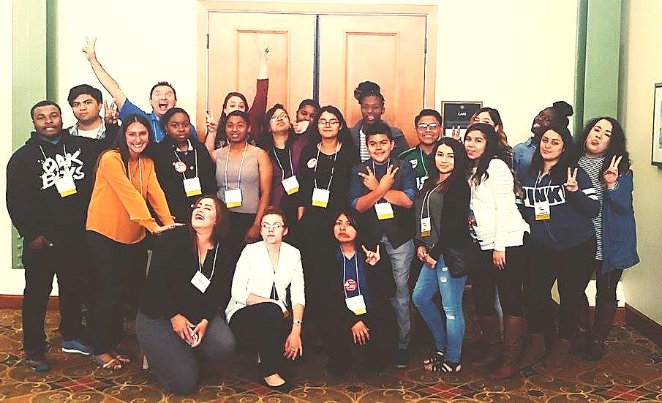
California School-Based Health Alliance
The California School-Based Health Alliance is the statewide non-profit organization dedicated to improving the health and academic success of children and youth by advancing health services in schools.
Our work is based on two basic concepts:
Health care should be accessible and where kids are
Schools should have the services needed to ensure that poor health is not a barrier to learning.
Notes:
5

Slide 6
Youth Voices: A Youth-Led Webinar Series

Slide 7
What is Youth-Centered Design Thinking?

Slide 8
Source: Design Thinking is the New Black by Clay Zeigler

Slide 9
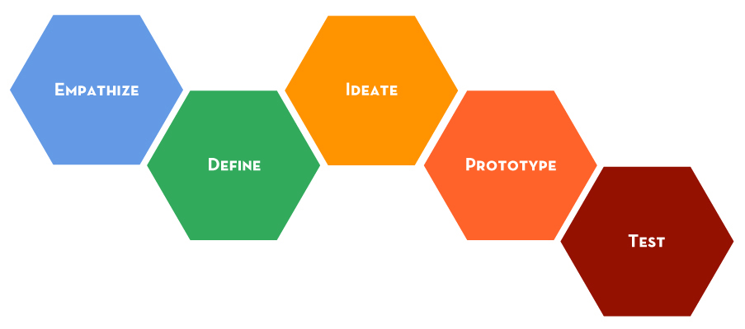
What is Design Thinking?
Source: Stanford Hasso Plattner Institute of Design

Slide 10
Design Thinking = Mindset + Methods

Slide 11
Why youth-centered?
“At many of the SBHCs in middle and high schools, youth are the primary stakeholders. Youth engagement enhances quality and operations of SBHCs and is an opportunity for young people to become empowered about their health.”

Slide 12
Mindsets
Creative Confidence
Make It
Learn from Failure
Empathy*
Embrace Ambiguity
Optimism
Iterate, Iterate, Iterate
*Youth-Centered
Source: The Field Guide to Human-Centered Design by IDEO.org

Slide 13
What is Design Thinking?
Inspiration

Slide 14
What is Design Thinking?
Ideation

Slide 15
What is Design Thinking?
Iteration

Slide 16
Inspiration
Frame Your Design Challenge
Build a Team
Secondary Research
Interviews (Individual, Group)
Immersion
Turn Learnings into Stories
Define Insights
Source: The Field Guide to Human-Centered Design by IDEO.org

Slide 17
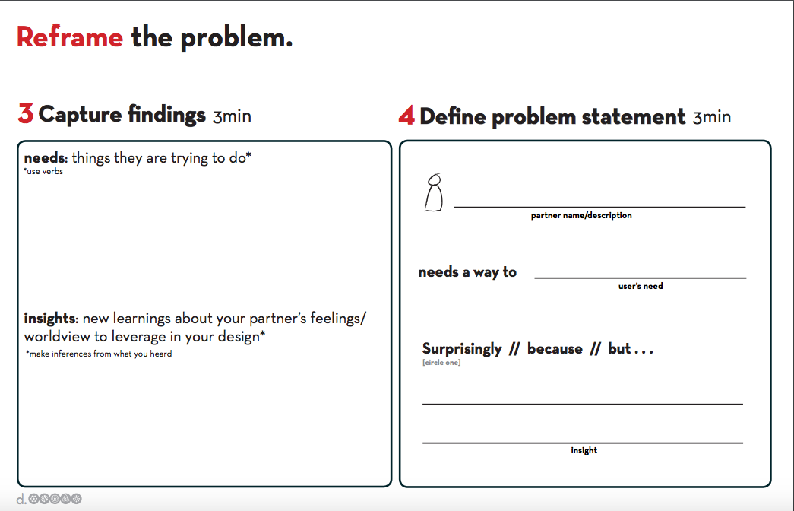
Source: Stanford Hasso Plattner Institute of Design

Slide 18
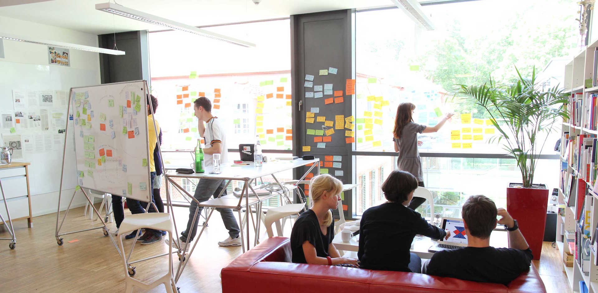
Source: Stanford Hasso Plattner Institute of Design

Slide 19
Case Study: Peer Health Exchange + IDEO.org
Designing a Transformational Volunteer Experience

Slide 20
Case Study: Peer Health Exchange
Research: 60+ subject interviews
Insights:
Some college students can’t afford to volunteer.
Training and testing can be intense and lonely.
If they make it to the classroom, volunteers get hooked.
Volunteers seek community, but they don’t always find it.
Volunteers want to speak and be heard.
Volunteers want to know they are making a difference.
Opportunities for growth are limited for some.
Different colleges have different needs.

Slide 21
Ideation
Generate Ideas (Post-Its!)
Refine Ideas
Make a Prototype
Get Feedback

Slide 22
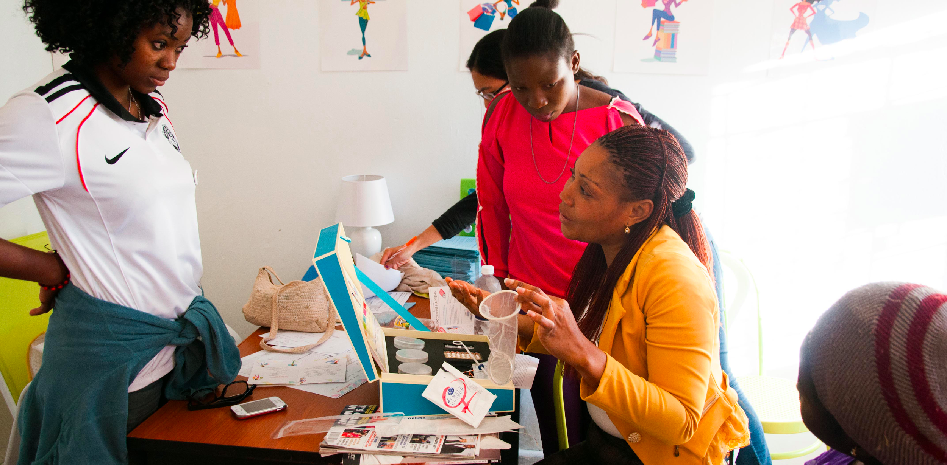
Case Study: IDEO.org Diva Centers
Source: IDEO.org

Slide 23
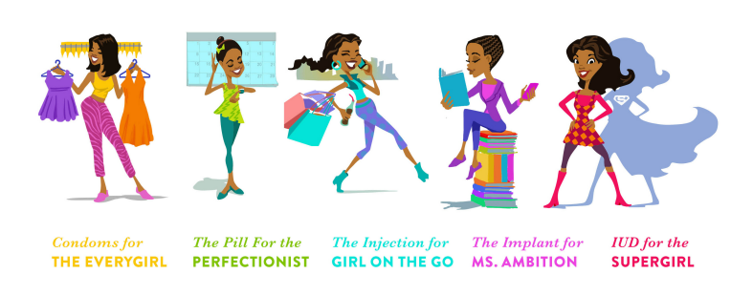
Case Study: IDEO.org Diva Centers
Source: IDEO.org

Slide 24
Implementation
Integrate Feedback
Live Prototyping
Track Learnings
Iterate, Iterate, Iterate

Slide 25
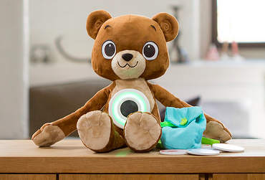
Case Study: Design for America and Jerry the Bear
Source: Sproutel

Slide 26
Source: Design Thinking for Business Strategy by Danny D. Kosasih

Slide 27
Youth-Centered Design Thinking = young people are your users and your co-designers

Slide 28
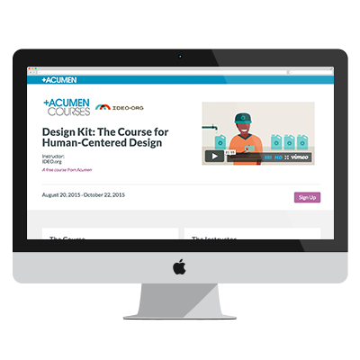
Resources
IDEO.org
Stanford d.school
YLabs
Design for America
Acumen Fund

