Slide 1
Youth Medical Pathway
to Health
Notes:
‹#›

Slide 2
Webinar Housekeeping
Everyone is in “listen-only” mode.
Two listen options: phone or web (phone tends to be better!)
Type questions in "chat box" located in the sidebar to the right.
If you are having technical difficulties please be sure to address the panelists and we will do our best to help you.
The webinar is being recorded.
Supporting materials will be available on our website within one week of this webinar.

Slide 3
Presentation Objectives
Upon completion of this webinar, participants will be able to:
Identify some pathways to enter health field
Describe the differences between different types of pathways
Discuss about your interests in these pathways

Slide 4
Introduction
Molly Wu
Youth Board Member

Slide 5
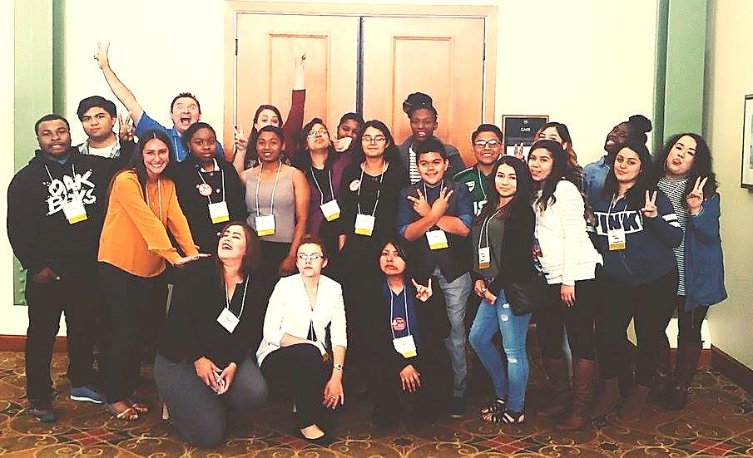
California School-Based Health Alliance
The California School-Based Health Alliance is the statewide non-profit organization dedicated to improving the health and academic success of children and youth by advancing health services in schools.
Our work is based on two basic concepts:
Health care should be accessible and where kids are
Schools should have the services needed to ensure that poor health is not a barrier to learning.
Notes:
‹#›

Slide 6
General Medical Career Pathway
Graduate from high school
Obtain a Bachelor's degree
Take the Medical College Admissions Test (MCAT)
Graduate from Medical School
Complete a medical residency training program
Complete fellowship training
Get a State Medical License

Slide 7
Step 1. Graduate from high school
Required for college admission
Opportunity to explore pre-med courses and extracurricular activities (chemistry, physics, biology, etc.)
Can help determine if the medical field is for you

Slide 8
Step 2. Obtain a Bachelor's degree
You can major in anything you want!
Completion of medical school requirements is necessary
Strong GPA
Courses and extracurricular activities

Slide 9
Step 3. Take the MCAT
Changing in 2014 to include biochemistry, psychology, and sociology, increasing the number of classes
Test content that’s taught in year-long introductory courses in biology, general chemistry, organic chemistry, and physics.
Verbal reasoning and scientific reasoning.

Slide 10
Step 4. Graduate from medical school
Required Time about 4 years
Obtain a medical degree such as an M.D. (allopathic medical degree), PhD (doctorate) or D.O. (doctorate of osteopathic medicine) from an American medical school
Notes:
4 years in US

Slide 11
Step 5. Complete a medical residency training program
Required time 3-5 years (depending on specialty)
The length of the medical residency training program you must complete varies according to the medical specialty in which you are training.

Slide 12
Step 6. Complete the fellowship training
A fellowship training program may be as short as 6 months or up to 3 years in length. (varies per specialty)
Not all medical doctors must do fellowship training. Certain medical specialties require fellowship training, such as cardiology and gastroenterology. Some fellowships are optional, such as certain types of surgical training.

Slide 13
Step 7. Get a medical license
Required time: several hours to complete application and gather documentation, and then wait for 3-9 months
In addition to your US medical license, you must also have a state medical license in the state where you plan to practice.

Slide 14
Before College
Focus on science and math courses and take advantage of AP/Honors/IB courses.
Maintain a good GPA. The higher your GPA and the more you participate in extracurricular activities, the better your chances will be of getting accepted into the colleges of your choice.

Slide 15
College Pathway
1 year of General Chemistry and 1 year of Organic Chemistry
1 year of each: Physics, Biology, Mathematics, English
Strongly recommend 1 semester of each: Psychology, Sociology, Statistics and Biochemistry

Slide 16
Different Medical Career Professions you can pursue
Doctor of Medicine
Doctor of Osteopathic Medicine
Physician's Assistant
Doctor of Podiatric Medicine
Doctor of Optometry

Slide 17
Doctor of Medicine
Physician who examines patients, gather their histories and inform them on their health status
Minimum degree required is Doctor of Medicine Degree
Typically 8 years

Slide 18
Doctor of Osteopathic Medicine
Osteopathic physicians have a historically more holistic approach to medicine with an emphasis on bone and joint manipulation
Minimum degree required is Doctor of Osteopathic Medicine Degree
Typically 8 years

Slide 19
Physician's Assistant
Do basic medical tasks such as diagnosing illness, running tests, conducting physical exams, prescribing medications, ect.
Minimum degree required is Master's Degree in Physician Assistant Studies, Health Science or Medical Science
6-7 years

Slide 20
Doctor of Podiatric Medicine
Specializes in feet, ankles, and lower extremities. They can perform surgeries and exams, order therapy, etc.
Minimum degree required is Doctor of Podiatric Medicine Degree
8 years

Slide 21
Doctor of Optometry
Specializes in vision. They can perform surgery as well.
Minimum degree required is Doctor of Optometry Degree
8 years

Slide 22
Thank you!
Reminder: All materials and a recording of this webinar will be available by the end of this week.

