Slide 1
School-Based Health in California
Putting Health Care Where Kids Are
www.schoolhealthcenters.org
Notes:
Basic Outline:
We think we are working a lot on the same issues and we would like to work in tandem with you.
SBHC 101 (slides 3-6)
What SBHCs can do (slides 7-11)
Successful Programs (slides 7-11)
Benefits to HPs (slides 12)
Where are there more opportunities (??)
Next steps/asks

Slide 2
How Can School-Based Health Centers Partner With You?
Children spend a lot of time at school.
Schools are trusted by families to provide resources and support.
We can help connect you to our school partners to reach even more of your members.

Slide 3
About Us
We are the statewide nonprofit organization helping to put more health services in schools
Our mission: Improve the health and academic success of children and youth by advancing health services in schools

Slide 4
What Is a School-Based Health Center?
School-based health centers are at or adjacent to school and provide primary care like any health clinic SBHCs offer:
Enhanced access to health care for kids
Strong prevention & population health
Intensive support for the highest need students
Support for the school’s mission to improve academic success
Integration into the health care system
Notes:
4
School-based health centers are effective because they put health care where students already spend most of their time – at school. They offer:
Enhanced access to health care by bringing it directly to where students and families are and conducting active school-based outreach to connect students with care.
Stronger prevention and population health by connecting clinical care with public health approaches such as group and classroom education, school wide screenings and prevention programs, or efforts to address the social determinants of health.
Intensive support for the highest need students by being present on a daily basis to manage chronic disease, address behavioral health issues, deal with crises, and help students and families access resources.
Support for the school’s mission to improve academic achievement by working together to address absenteeism, school climate, and classroom behavior and performance.
Integration into the health care system by communicating and coordinating care with other providers and payers.

Slide 5
Who Runs School-Based Health Centers?
Community health clinics
School districts
County health departments
Mental health providers
Community-based organizations
Hospitals
Notes:
5

Slide 6
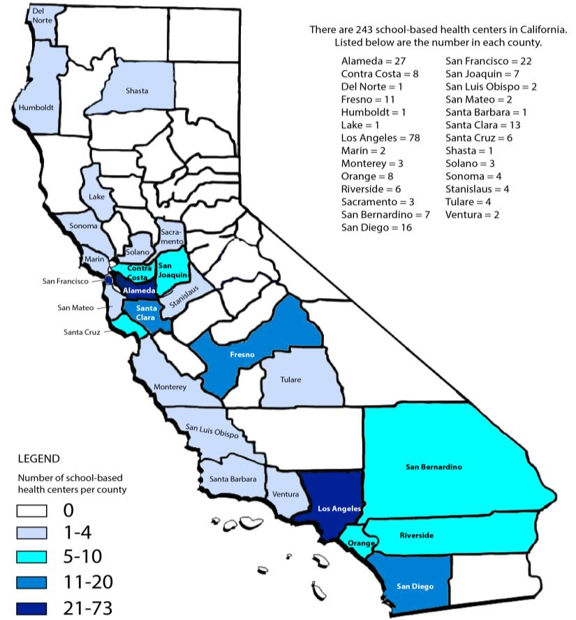
California’s 243 School-Based Health Centers
Notes:
6

Slide 7
Shared Goals: School-Based Health Centers & Health Plans
Providing community health education
Improving patient engagement & access to care
Managing chronic illness
Addressing social determinants of health
Notes:
Possible activity? Have health plans brainstorm top / prevalent / specific concerns under these 4 areas
Segue to following slides: Now we are going to illustrate how school-based health centers are doing some of this work already.

Slide 8
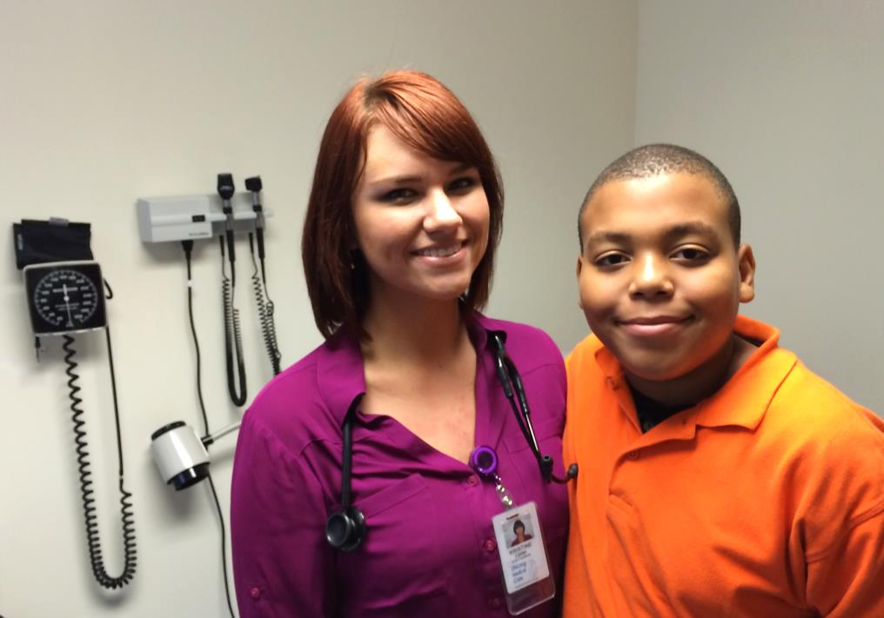
Helping Kids Breathe Easy at School
“Sometimes it feels like I just can’t breathe”
Notes:
When Maurice started middle school in West Oakland, he couldn’t catch up with the other boys on the playground because of his asthma.
His school is near two major highways, a port, and plenty of industrial activity. Big trucks roll down the street all day long.
Thankfully, the school-based health center has helped him with his asthma. A nurse and a physical education teacher use a combination of high-tech tools - like a spirometer - and practical knowledge to help Maurice take deep breaths and calm himself when he’s having an asthma attack.
They have coached him on easy ways he can prevent and manage his asthma, and now he joins his friends on the blacktop at recess and after school. Getting help so he can stay physically active has helped Maurice stay happy and focused at school.
Last year, West Oakland Middle School had four asthma-related ER emergency calls for students at school. This year there have been NONE.

Slide 9
Improving Community Health
School-based health centers work outside of clinic walls to address the social determinants that shape population health
Partnering with corner stores to carry more fresh fruit & vegetables
Providing healthy breakfast for students who walk to school
Offering job training & tutoring programs to support graduation
Screening for trauma
Notes:
- JFK High in Richmond partners with local liquor stores to carry fresh fruits
- San Fernando High provides healthy breakfast for students who participate in their “Walking Bus”
- Castlemont High in Oakland provides job training and tutoring programs to support high school graduation
- Wellness Centers in L.A. screen patients for trauma

Slide 10
Preventing Obesity
School-based health centers can identify at-risk patients, work with the whole family, & prevent obesity
Screening entire 9th grade to identify students with high BMI%
Connecting to individual care
Using groups to support healthy behaviors
Engaging parents to change home environment
Notes:
Centro Medico Coachella’s Fit & Healthy Program at Coachella Valley High:
-Screening entire 9th grade to identify students with high BMI%
-Connecting to individual care
-Using groups to support healthy behaviors
-Engaging parents to change home environment

Slide 11
Improving Nutrition
School-based health centers provide accessible, age-appropriate health education to children & adolescents in the classroom
Implementing evidence-based nutrition education in the classroom
Measuring increase in knowledge & behavior change of participants
Sharing member information with the partnering health plan
Notes:
Havenscourt SBHC & Alameda Alliance for Health
- Implementing evidence-based nutrition education in the classroom
- Measuring increase in knowledge and behavior change of participants
- Sharing member information with Alameda Alliance

Slide 12
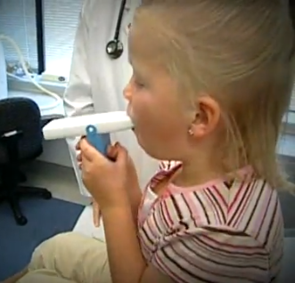
Managing & Preventing Asthma
School-based health centers manage chronic conditions to reduce school absences & avoid preventable ER visits
District nurses identify students with asthma
Engage parents & families via home visits
Conduct classroom education
Provide individual care & medical case management
Share member data with the partnering health plan
Notes:
Bakersfield City School District & Kern Health Systems
- District nurses identify students with asthma
- Engage parents/families via home visits
- Conduct classroom education
- Provide individual care and medical case management
- Share member data with Kern Health Systems

Slide 13
Providing Trauma-Informed Care
School-based health centers actively screen & identify early mental health needs of students
Trauma screening administered in classrooms
Students dealing with mild/moderate symptoms of trauma are given care at school
Students needing specialty care are referred to community partners
All students are connected to primary care
Notes:
Hawthorne Middle in Oakland
-Trauma screening administered in classrooms
-Students dealing with mild/moderate symptoms of trauma are given care at school
-Students needing specialty care are referred to community partners
-All students are connected to primary care

Slide 14
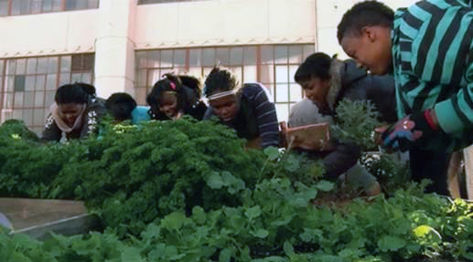
How School-Based Health Centers Can Help Health Plans
Offer health education that is high impact, population specific, cost effective, & convenient
Share encounter data and help meet quality measures.
Share valuable best practices on treating kids & offering group education
Tap into proven success preventing and managing chronic health conditions

Slide 15
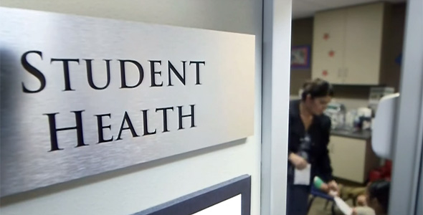
How Can We Partner With You?
How can a partnership with a school-based health center enhance your plan’s impact in the community?
Are there health conditions your plan needs to address?
Are there innovative ways you have been engaging with children that we should be sharing with our field?

Slide 16
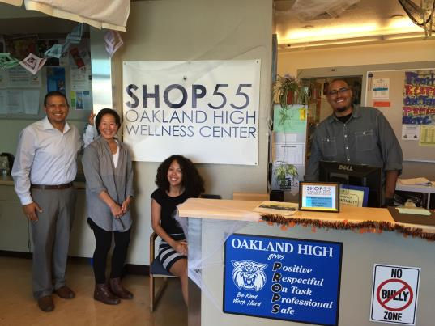
Next Steps
Tour a school-based health center – we can set this up!
Meet with school-based health center staff to learn about existing services or programs
Work with us to host a local convening of school-based health centers & health plan representatives
Develop a plan to partner with a school-based health center

Slide 17
Stay in Touch
Salina Mendoza – smendoza@schoolhealthcenters.org
Juan Taizan – jtaizan@schoolhealthcenters.org
Lisa Eisenberg – leisenberg@schoolhealthcenters.org
www.schoolhealthcenters.org

