Slide 1
Healing Centered Relationships
Building Safe Learning Partnerships

Slide 2
Building the Foundation
Why are relationships foundational to teaching?
Why are relationships an important part of culturally-responsive teaching?
When was the last time you were truly engaged in learning? Who was the educator/trainer? Why were you engaged?

Slide 3
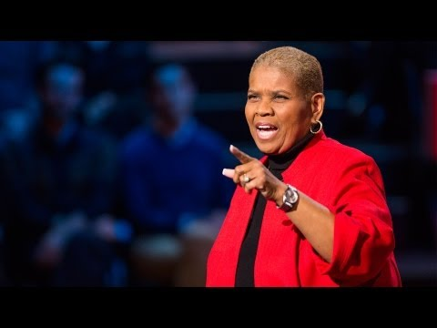
Notes:
Kids don’t learn from teachers they don’t like

Slide 4
Rapport + Alliance = Cognitive Insight
-Culturally Responsive Teaching & The Brain, Zaretta Hammond

Slide 5
“Trust between teachers and students is the affective glue that binds educational relationships together. Not trusting teachers has several consequences for students. They are unwilling to submit themselves to the perilous uncertainties of new learning. They avoid risk. They keep their most deeply felt concerns private. They view with cynical reserve the exhortations and instructions of teachers.” Stephen Brookfield, The Skillful Teacher (p 162)

Slide 6
Assessing Rapport
Quick Assessment of Relationships:
What do they like to do after school?
What excites them?
What scares them?

Slide 7
Trust generators
Selective Vulnerability
Familiarity
Similarity & Interests
Concern
Competencence

Slide 8
3 Parts of an Alliance
The Pact
Teacher as Ally & Warm Demander
Student as Driver of Their Own Learning

