Slide 1
Welcome!
Healing-Centered Schools, Advanced Practice Cohort

Slide 2
Where are we going?
Notes:
8 min

Slide 3
Principles of Trauma-Informed Care
SAFETY
TRUSTWORTHINESS + TRANSPARENCY
PEER SUPPORT
COLLABORATION & MUTUALITY
EMPOWERMENT & CHOICE
CULTURAL RESPONSIVENESS

Slide 4
Healing-Centered Engagement
Builds on & moves us beyond trauma-informed care...
Acknowledges how trauma is experienced collectively, not just individually
Considers how the root causes of trauma exist in the environment, not just the individual
Focuses on healing & restoration--not just coping with symptoms
Supports adult providers/health care professionals in their own healing
Concept developed by Dr. Shawn Ginwright, Phd

Slide 5
The work begins with shifting perspective...
From “what’s wrong with you?”
To “what happened to you?”
And going further to ask:
“What’s right with you?”
“What skills have you used to survive?” “What are you good at? What brings you joy?” “What are your hopes & dreams?” “What does liberation & justice look like to you?”

Slide 6
Survival Brain→ Learning Brain
Notes:
12 min

Slide 7
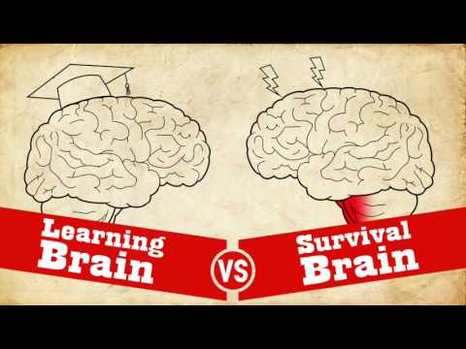

Slide 8
Interpretation guides intervention

Slide 9
Triggers
Not inherently “bad”
Set off the “survival brain” even in a seemingly safe environment
Unique to the person & trauma

Slide 10
Common Triggers for students & families
Loud noises
Being ignored
Being the center of attention
Authority figures
Police/Armed security
Perceived criticism
Having to say “yes”
Being told how to move one’s body
Being far from an exit
Unexpected touch
Unfamiliar stimuli
Not knowing an answer
Having to ask for help
Recall of trauma
Being alone in room with unfamiliar stranger
Being alone in room with person(s) of a particular gender or race (for example--in a group of men, in a group of primarily white people)
Emergency Drills
Sensory reminders of trauma

Slide 11
Fight
Fights to regain or hold power, especially when feeling coerced or threatened
LOOKS LIKE
“Acting out,” aggression, hyperactivity, explosive temper or outbursts demanding perfection, suicidal or homicidal ideation

Slide 12
Flight
Flees, disengages, or “checks-out” emotionally or physically
LOOKS LIKE
Withdrawing, failing to return for follow-up visits, changing the subject, can’t sit still or relax

Slide 13
Freeze
Psychological shut-down. Disengages from whatever is happening.
LOOKS LIKE
Dissociation, inability to answer questions, mistrustful, difficulty making or acting on decisions, isolating, avoiding phone calls

Slide 14
Fawn
Merging with the wishes, demands, and desires of others as a means of survival
LOOKS LIKE
Agreement, Apologizing, Placing others’ needs above one’s own, Praise, People-pleasing, avoid conflict

Slide 15
The foundation of a healing-centered school is built on transformative relationships

Slide 16
Homework!
Think about 2 students who exhibit fight-flight-freeze coping
What, if any, labels have been placed on them by adults in their community?
What are some common triggers that could be contributing to their responses?
What do you notice happens to them when they become triggered?
What do you notice happens to you when they become triggered?
What about their response may have been effective in a life-threatening situation?
What are they communicating to you through their response?
What do you know about that student’s life outside of school? What are their strengths?
Notes:
15

